Slide 1
Final Proposal
JIMMY LAUCHOY
DM-UY 2193
PROFESSOR ADEE

Slide 2
My final project is a continued development of my midterm. In addition to showcasing my photo and video works, I will also overhaul the design of the webpage to create a freeflow experience with the viewer. Many new features are added to enhance the overall look of the page and interactivity
FINAL WEBSITE CONCEPT

Slide 3
Current Homepage

Slide 4
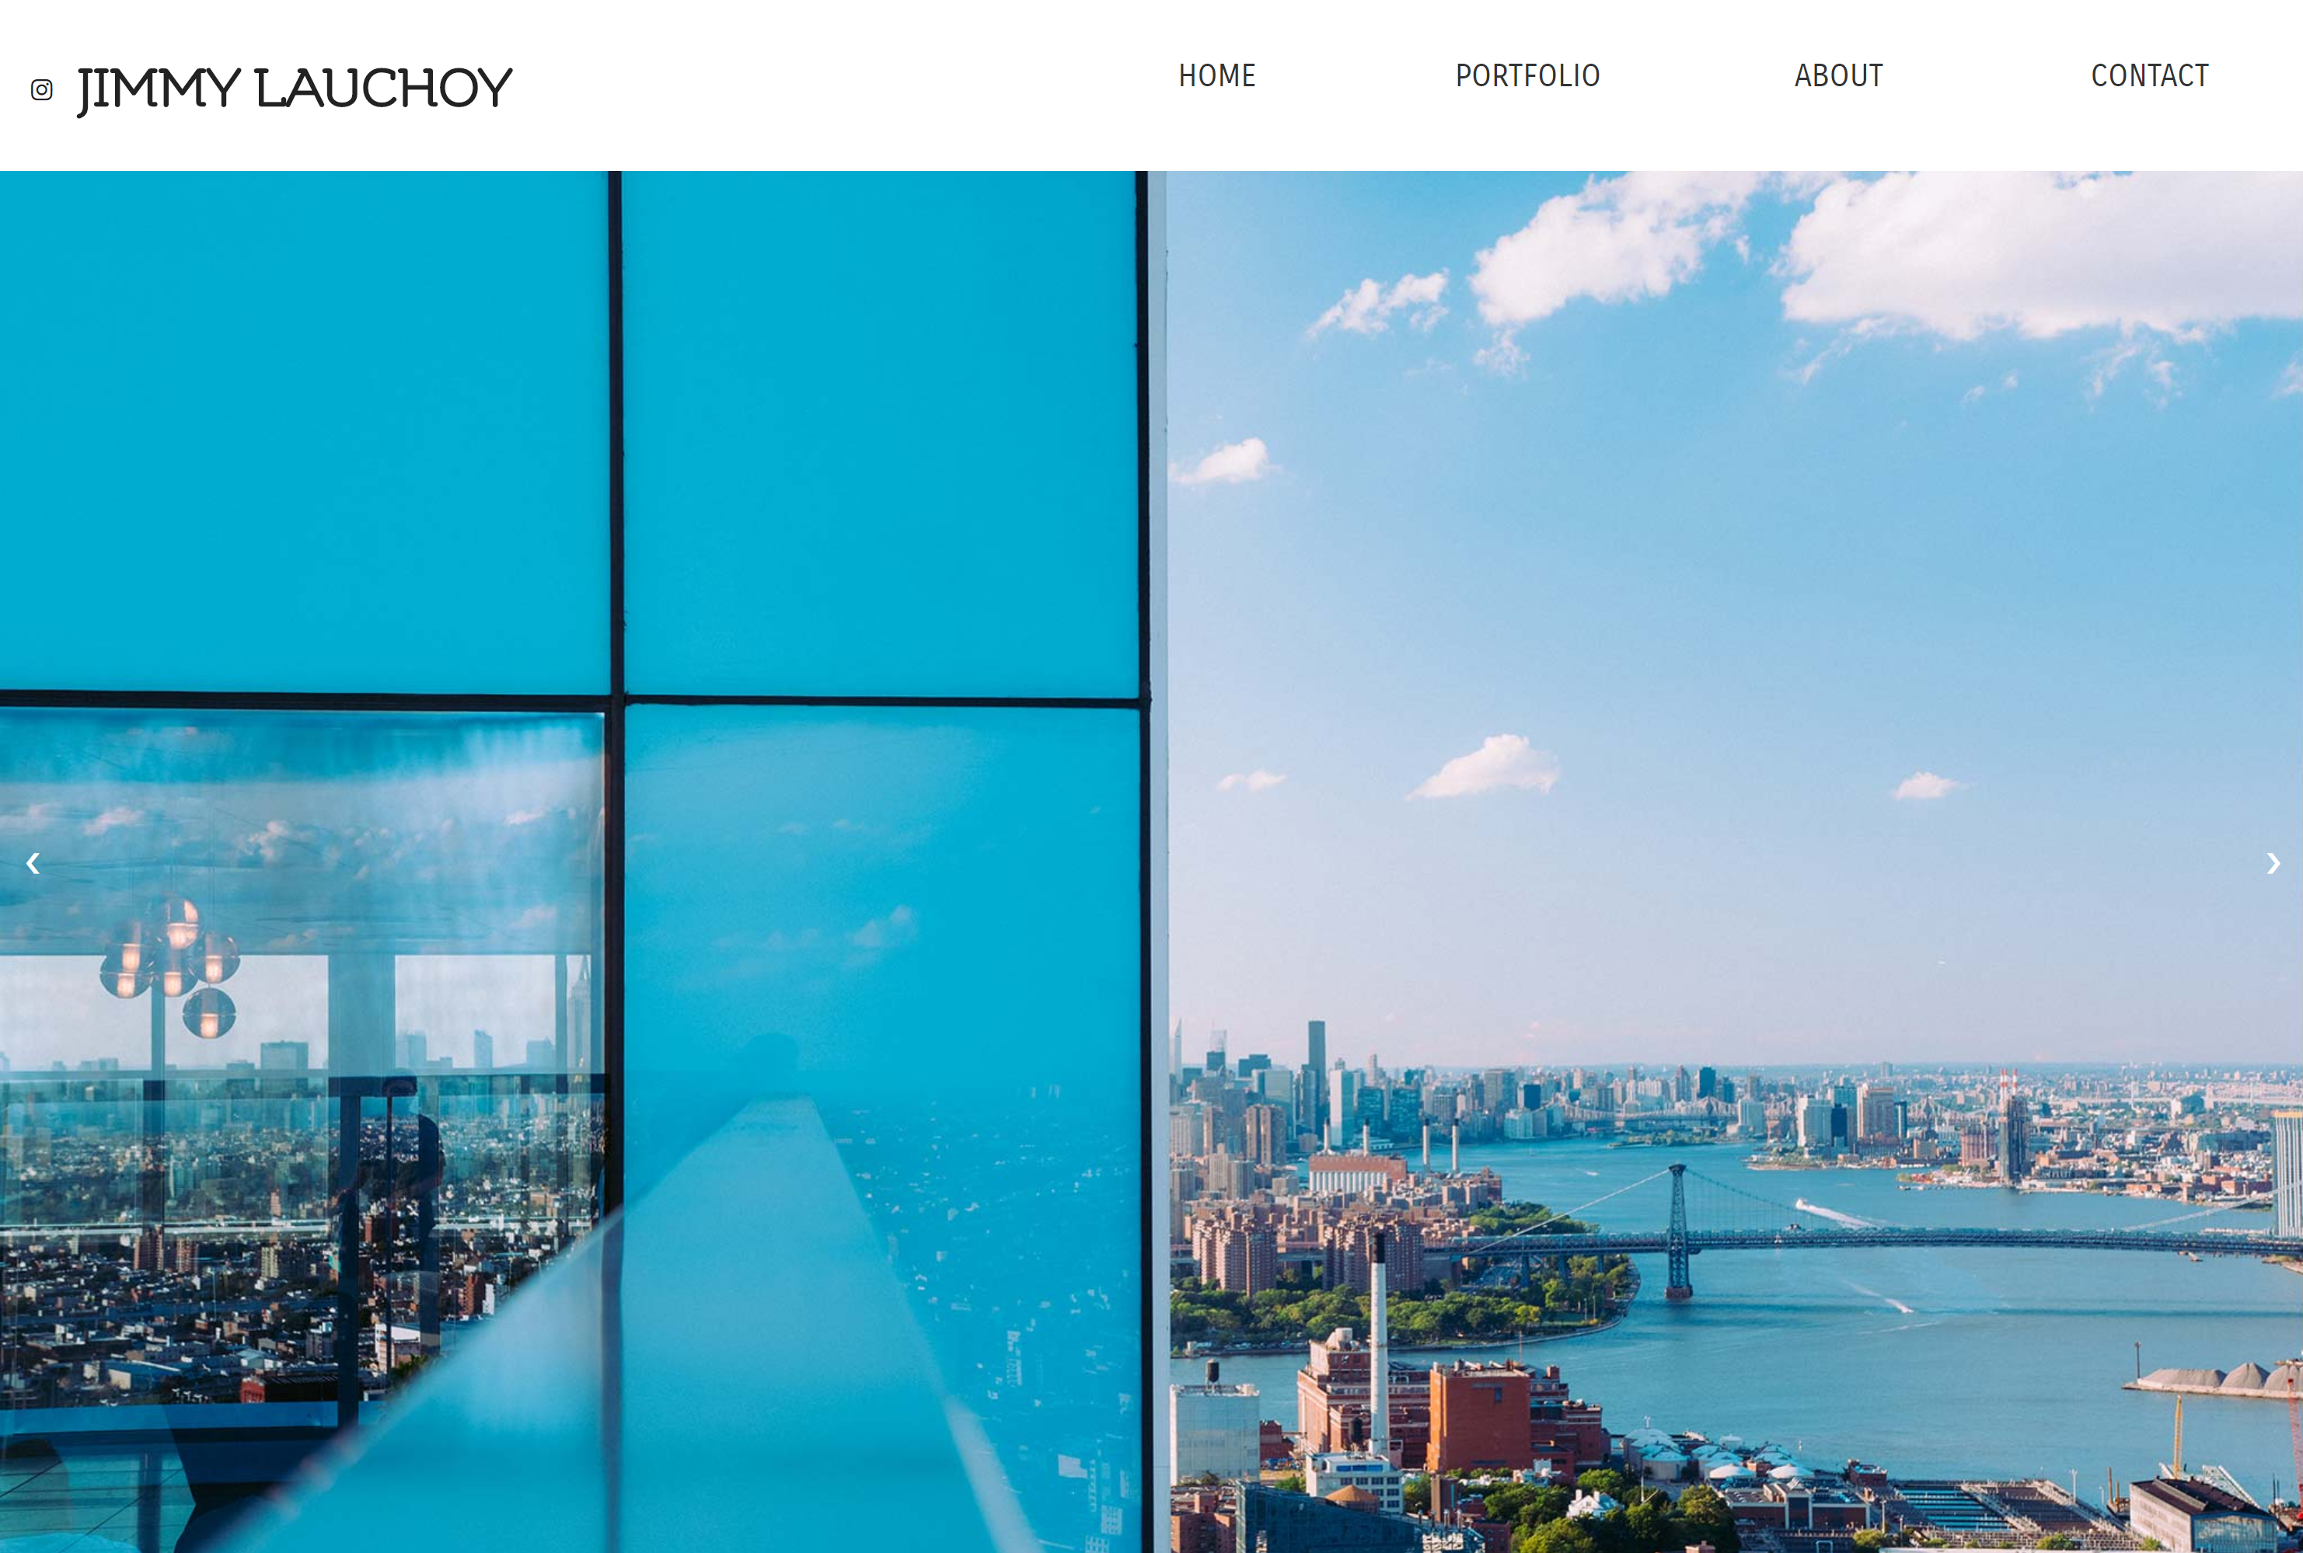
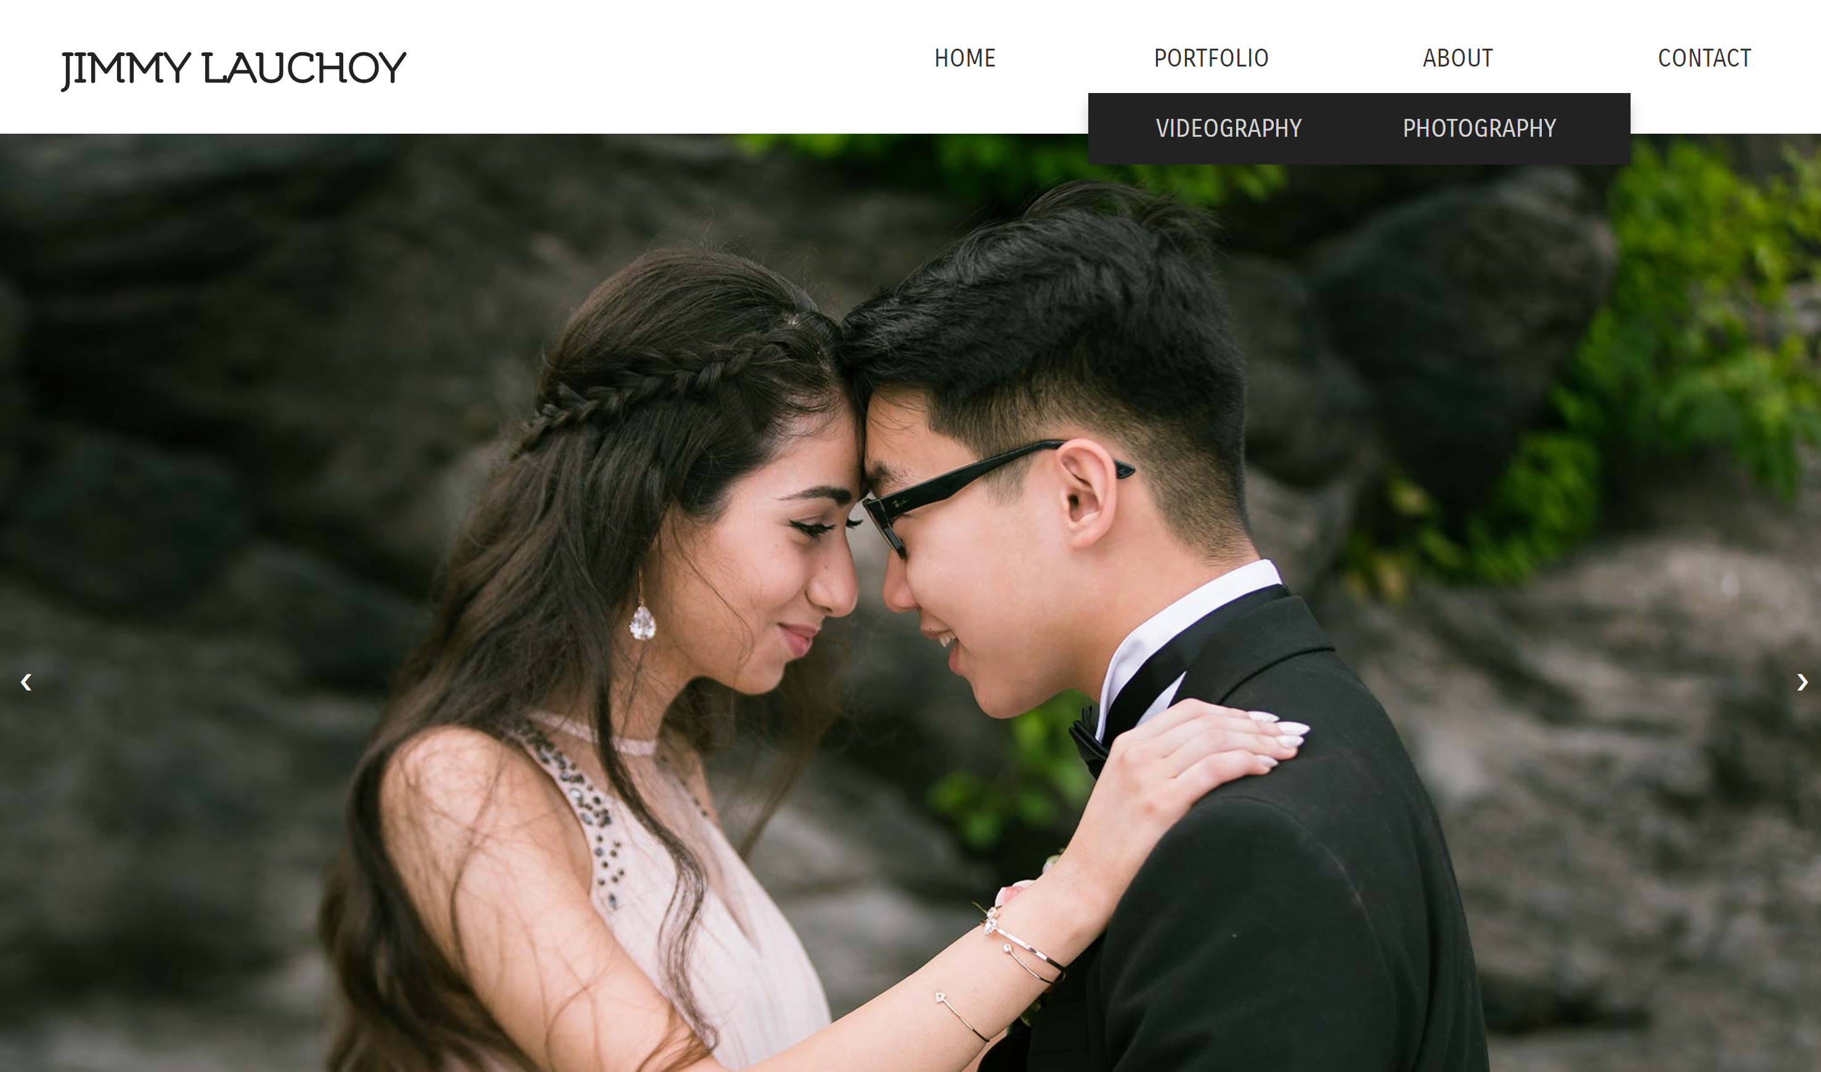
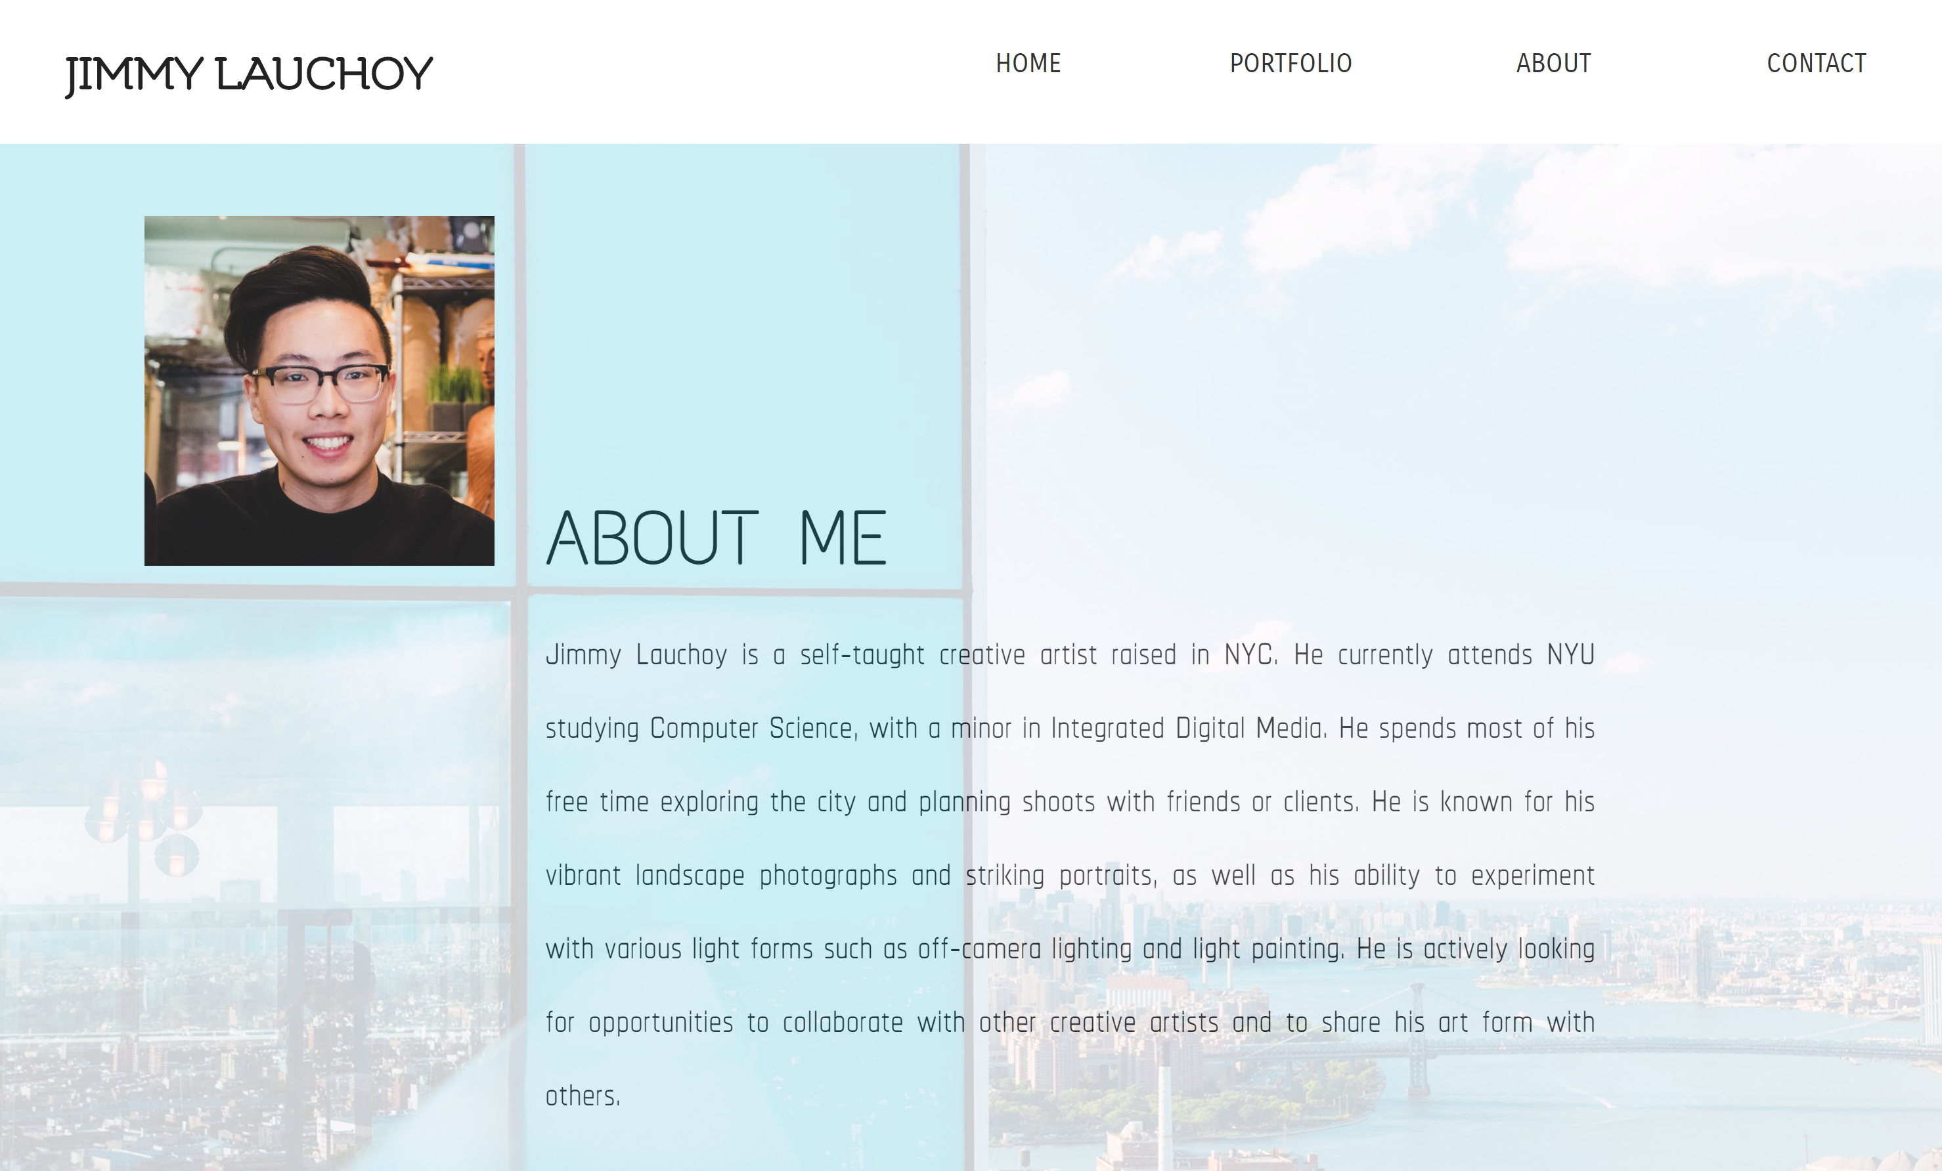
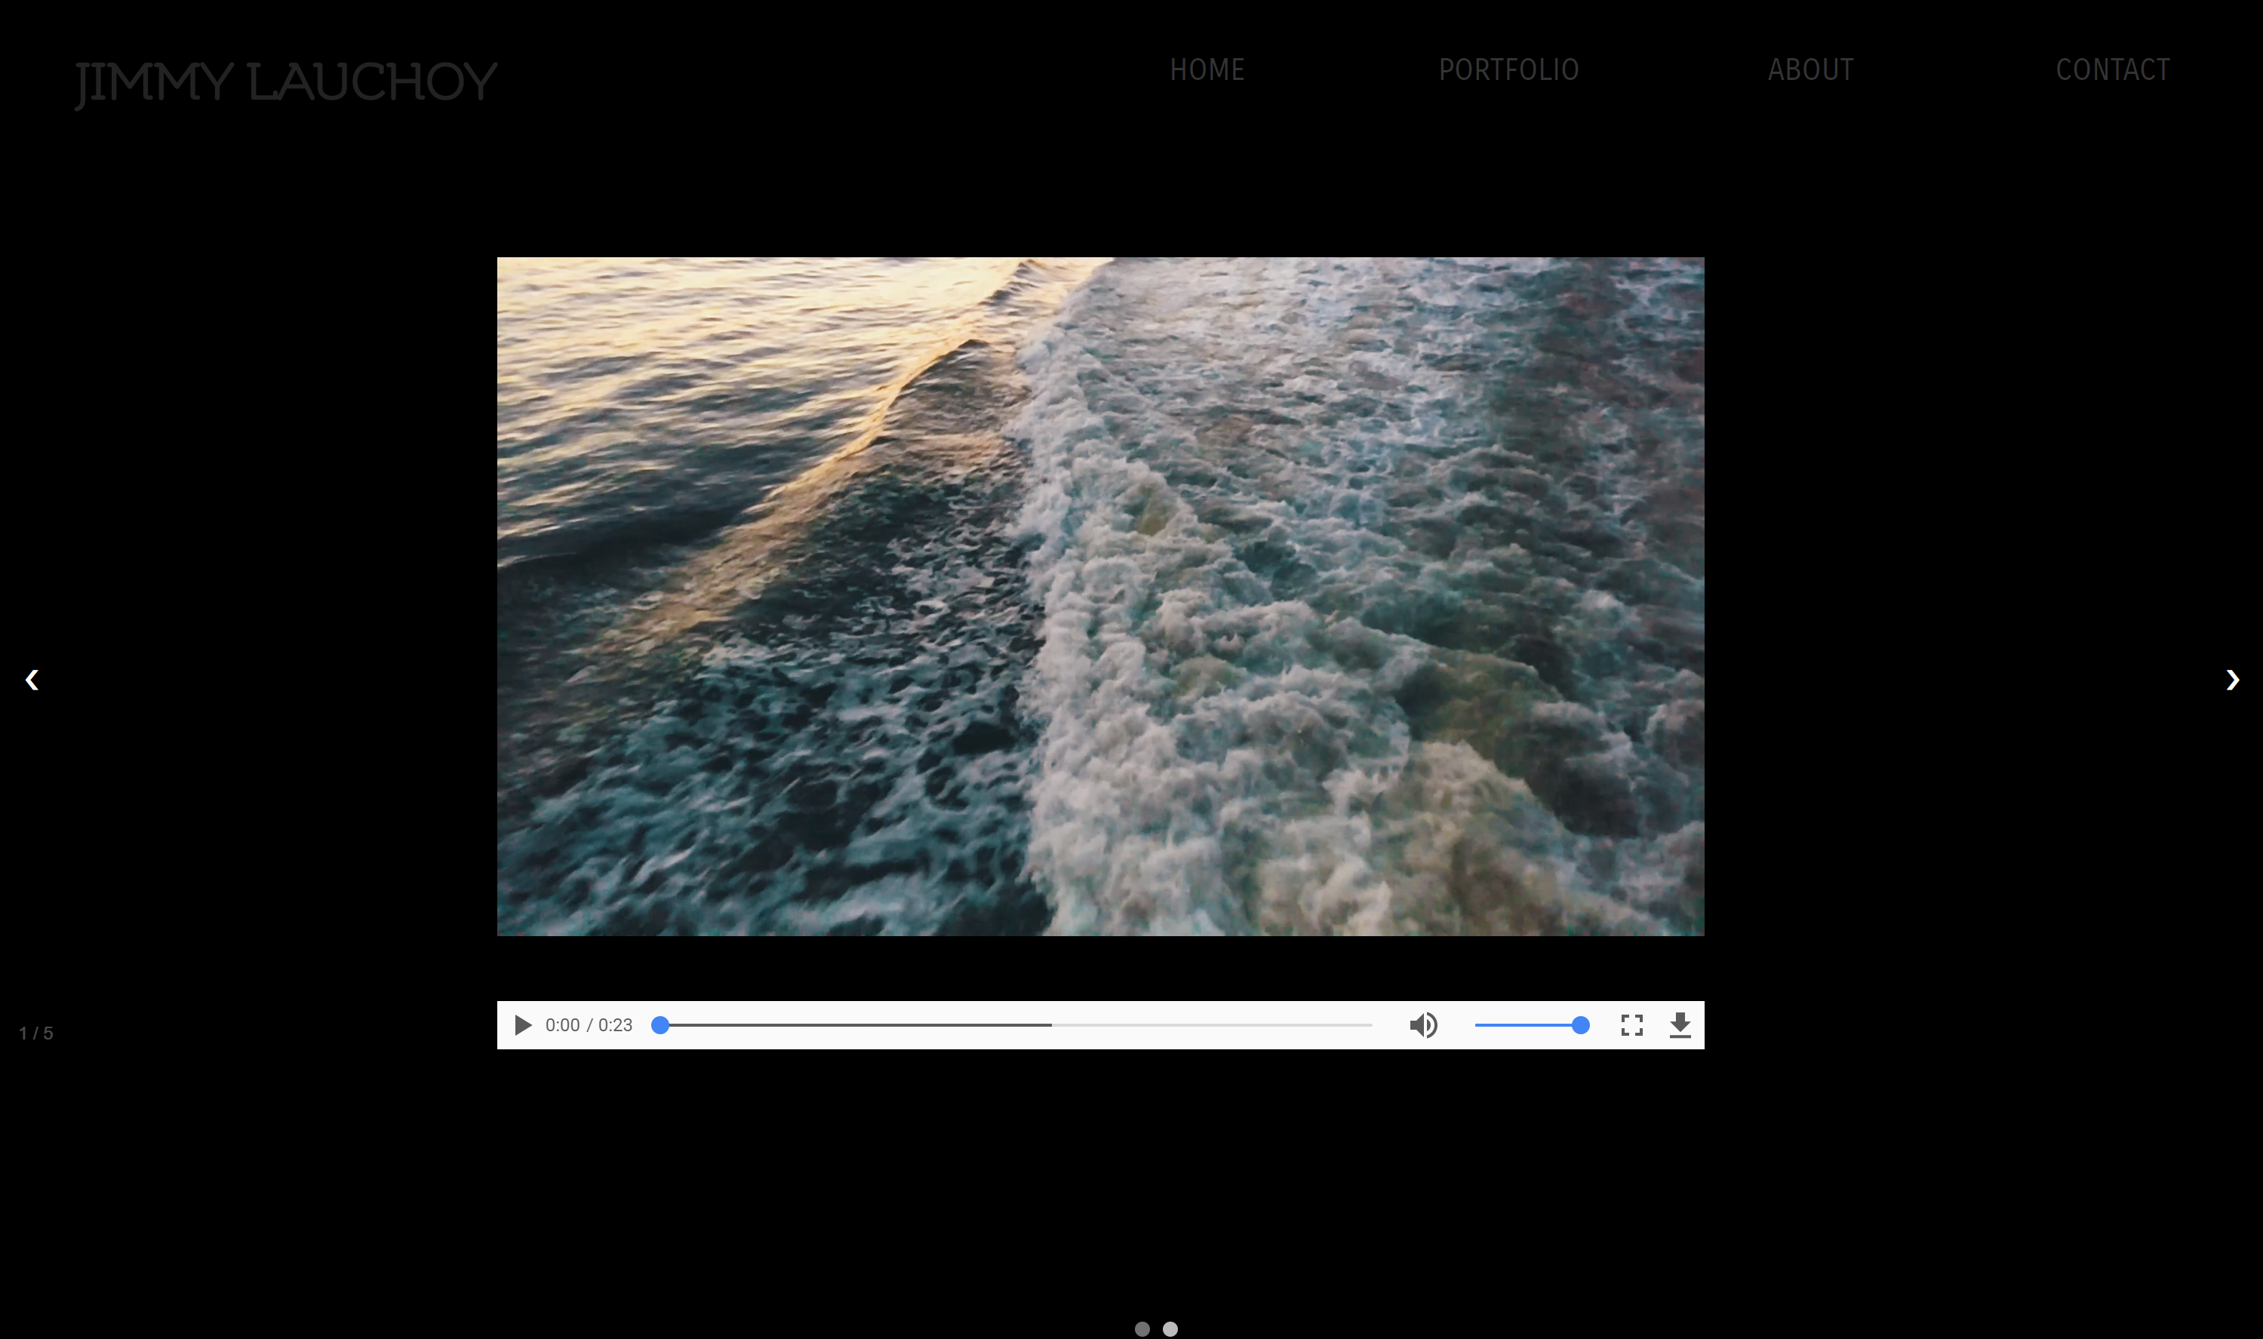
HOME
PHOTO
http://sites.bxmc.poly.edu/~jimmylauchoy/WD/
ABOUT
VIDEO

Slide 5
New Page Design

Slide 6
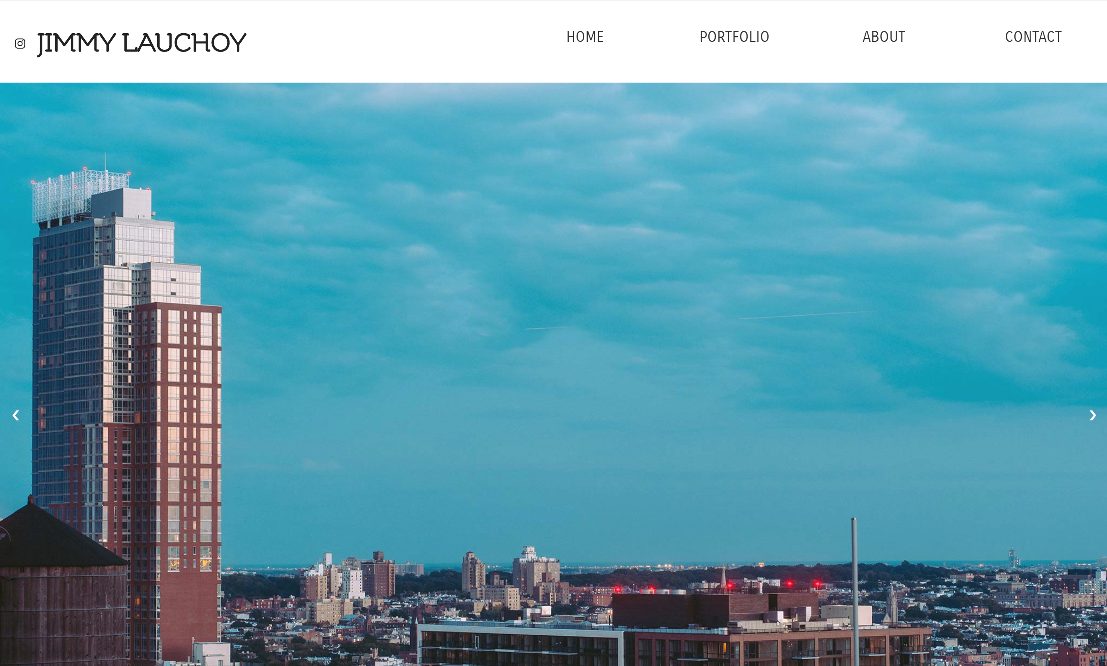
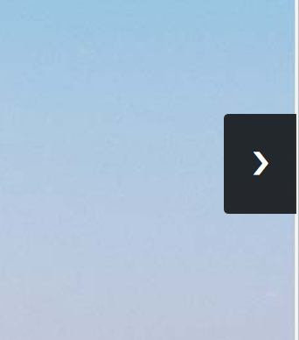

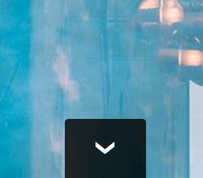
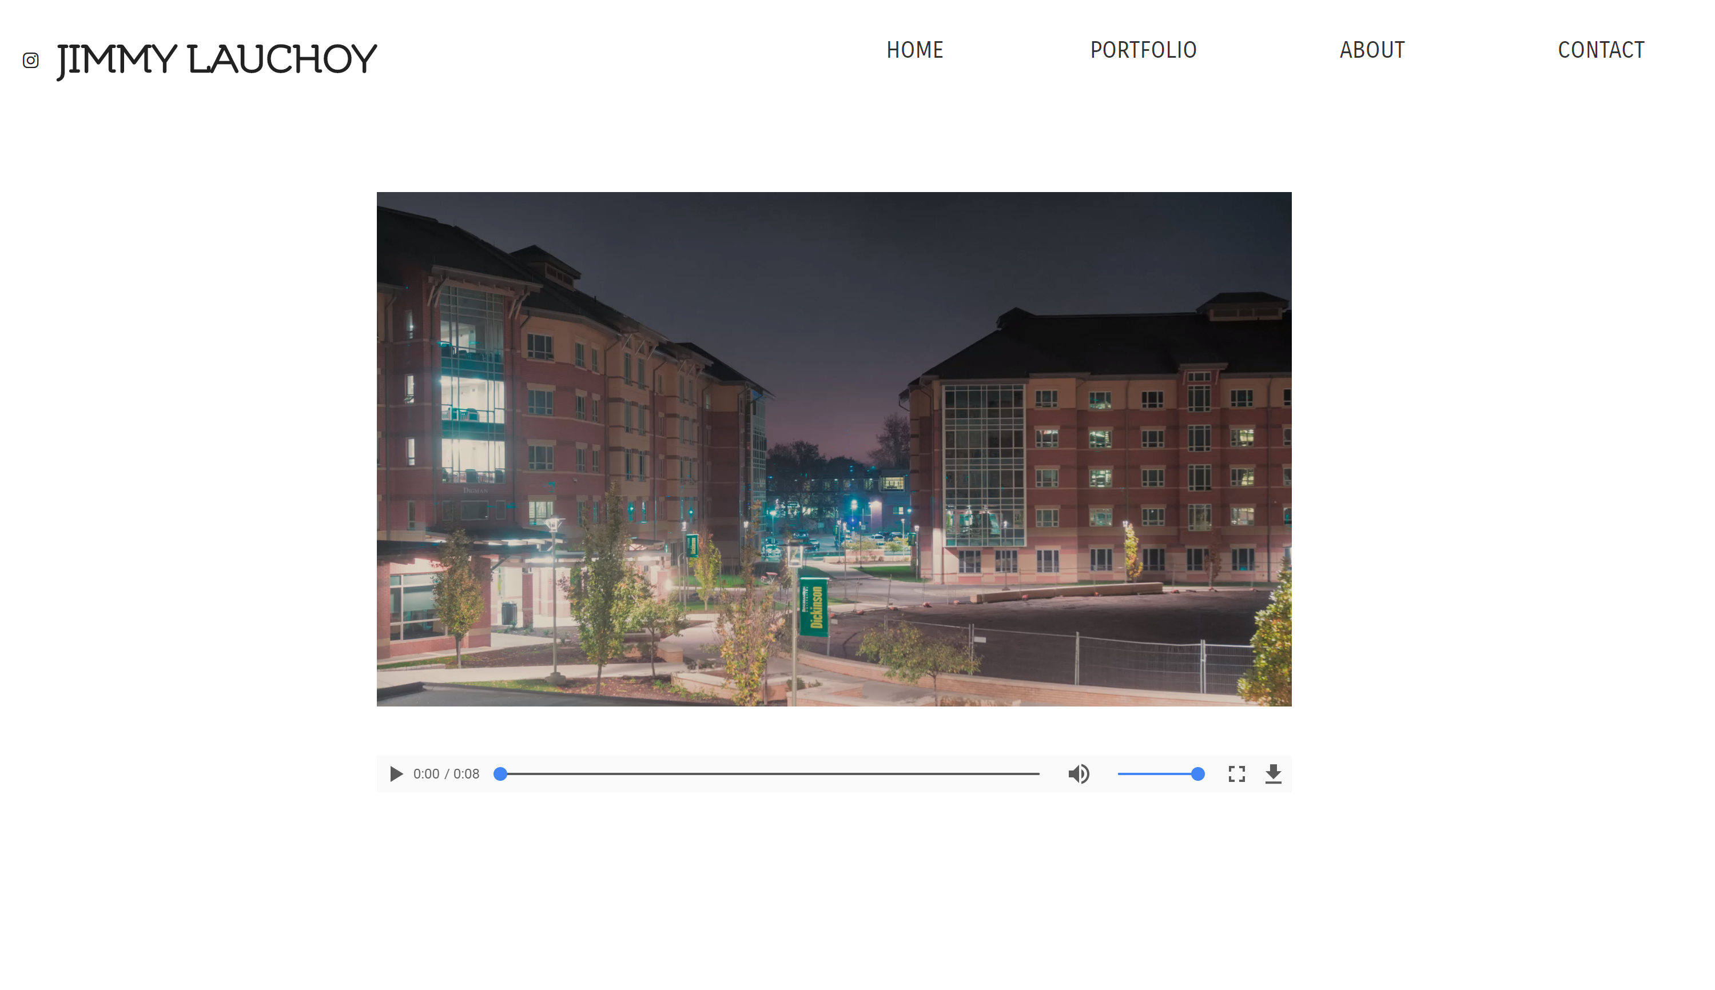
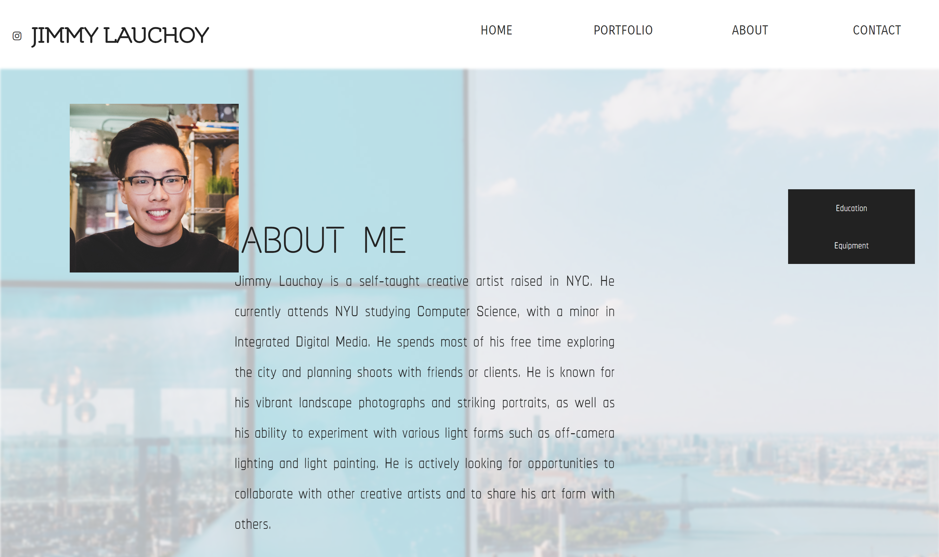
(Scroll down)

Slide 7
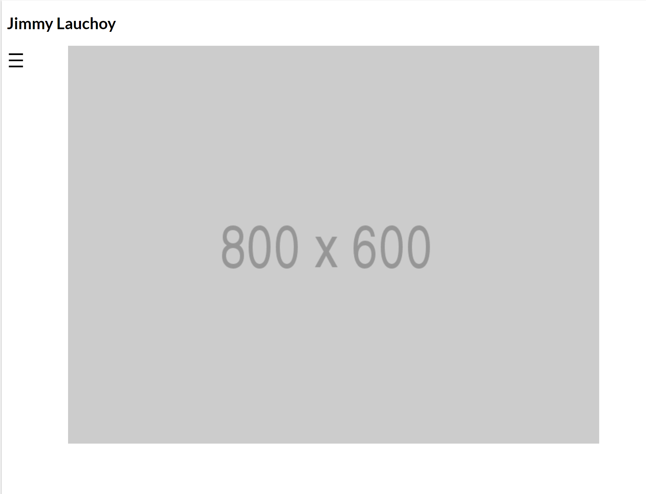

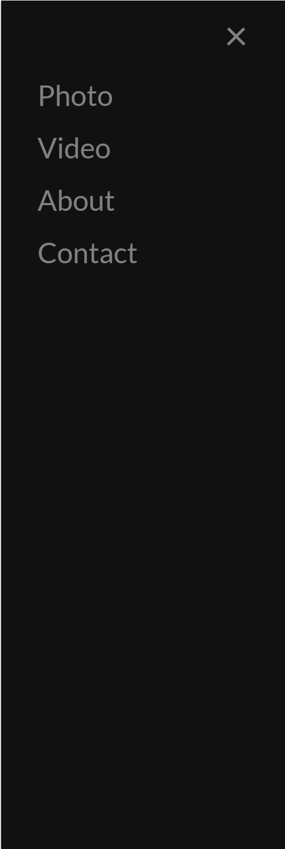
New Nav Bar

Slide 8
Photo categories (portrait, landscape, street, fashion, environmental, still life)
Nav bar on the side to switch between categories
Landing page (modal), fades out when “Enter” is clicked
Overhauled About page
ReactJS for button dropdowns for fun facts, gear list, achievements, etc
Contact page includes space for FAQs or requests
Buying photos/copyrighted content (tentative)
Use Stripe payment system
Fade in content when viewer is scrolling down the page
Better Cinema mode for video page
Interactive Resume page
Clicking on address under each Experience pops up a Google Maps modal
Use a better image compression algorithm in PS
Photos show artifacts when blown up on high-res displays
New Content
(Front End)

Slide 9
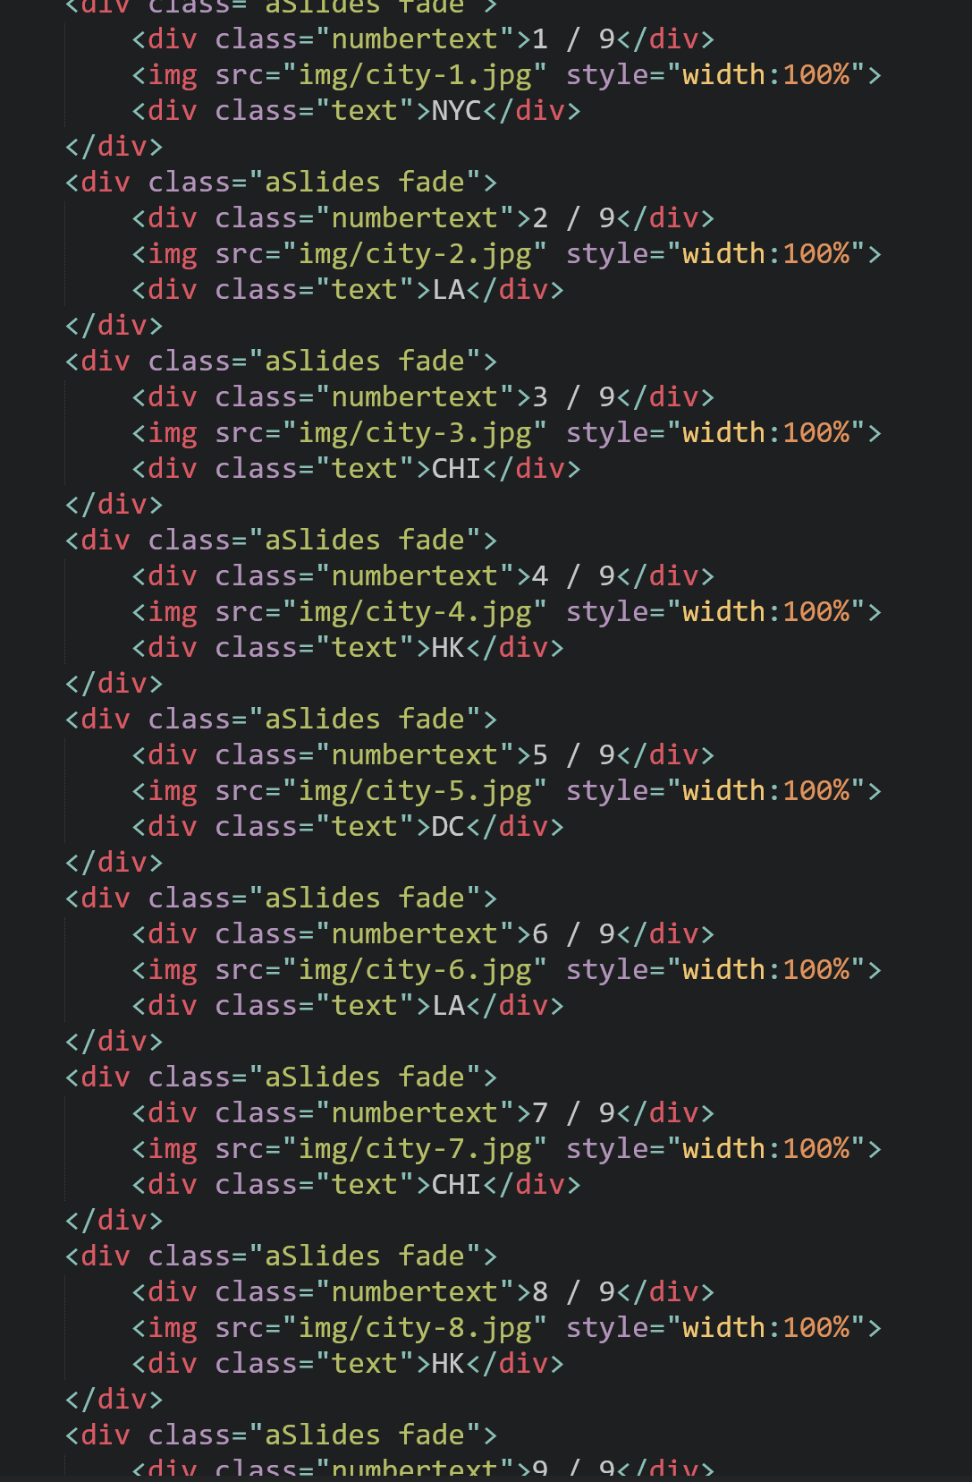
Automatically add media files from a folder using JS
New Content (Back End)

Slide 10


Navigation dots get automated as well (add a dot when a new image is added)
New Content (Back End)

Slide 11
New Content (Back End)
Improve load time of photos/videos
Click on image to go to the next photo
Content loading hierarchy
Text + styling -> media -> animations
Switch from 996 Grid to Bootstrap
Layout
Media object
Grid system (2: sidenav, content)
Components
Pagination, popover, scrollspy, forms
Utilities
Flexbox, sizing, spacing, typography, vertical align
Mobile device optimization (menus, content scaling, navigation)

Slide 12
FINAL GOAL
Host the webpage on my personal page: jimmylauchoy.com

